Slide 1
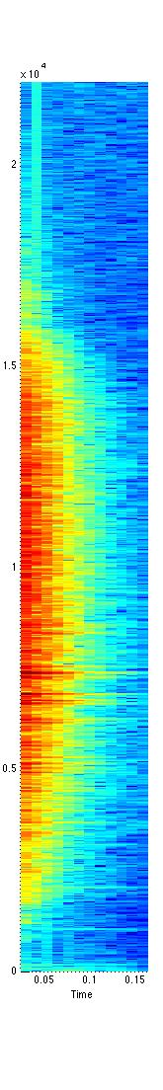
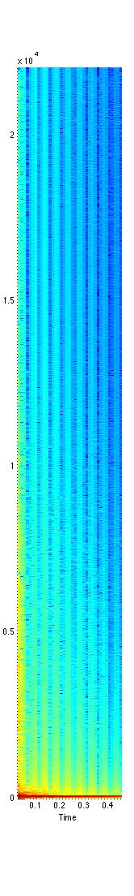
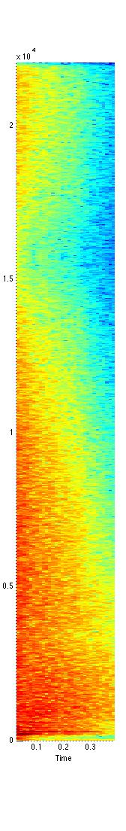
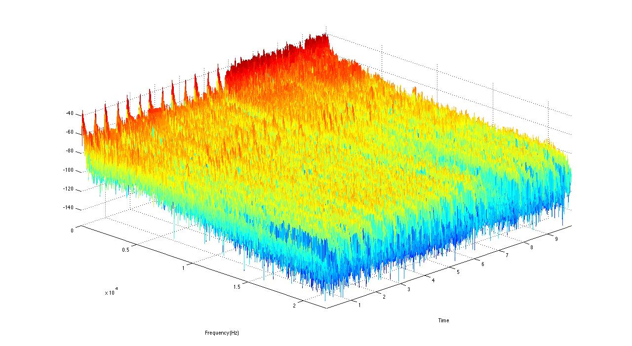
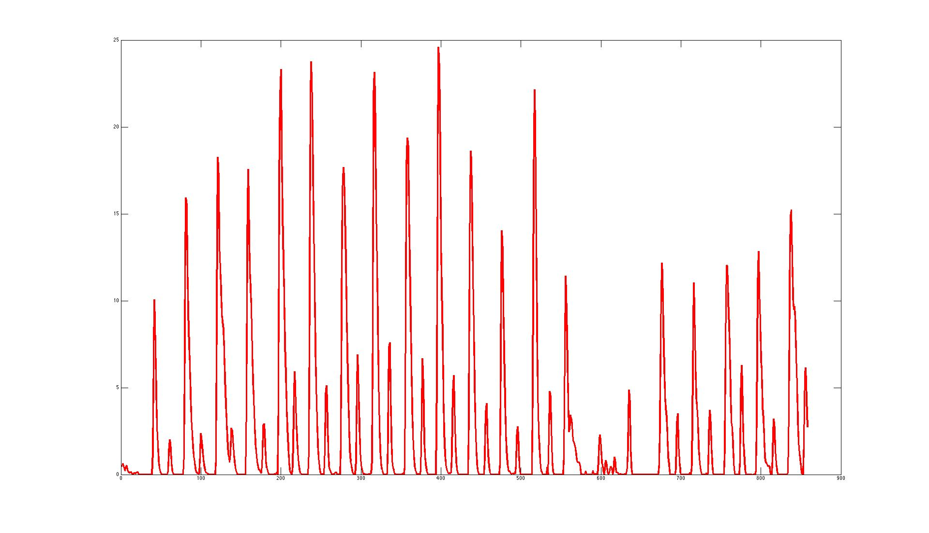
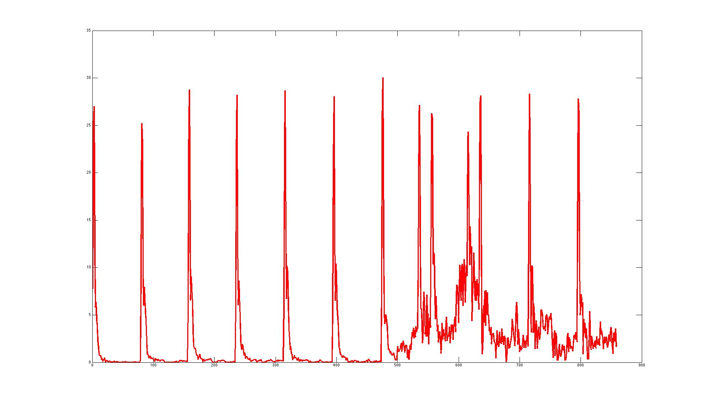
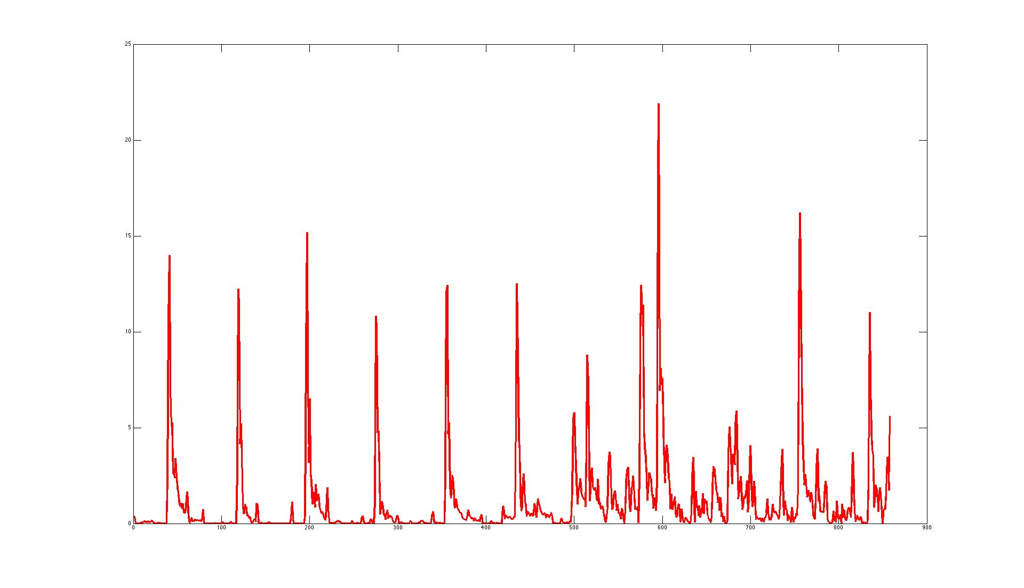

Pre-defined Templates
Undefined Entries
Harmonic Activation
HH
BD
SD
Training data
Template Extraction
+
Partially Fixed
NMF
Percussive Activation
Template Adaptation
HH
Music Signal
BD
STFT
SD
Detected Drum Events
Reference
[1] Lucas Thompson, Matthias Mauch, and Simon Dixon, “Drum Transcription via Classification of Bar-Level Rhythmic Patterns,” In Proceedings of the International Conference on Music Information Retrieval (ISMIR), 2014
[2] Olivier Gillet and Gael Richard, “Transcription and Separation of Drum Signals From Polyphonic Music,” IEEE Transactions on Audio, Speech, and Language Processing, 16(3): 529—540, 2008
[3] Olivier Gillet and Gael Richard, “ENST-drums: an extensive audio-visual database for drum signals processing,” In Proceedings of the International Conference on Music Information Retrieval (ISMIR), 2006
Fig 2. Illustration of the proposed method
For more information, please contact cwu307@gatech.edu

Slide 2
Pre-defined Templates
Undefined Entries
Harmonic Activation
HH
BD
SD
Training data
Template Extraction
+
Partially Fixed
NMF
Percussive Activation
Template Adaptation
HH
Music Signal
BD
STFT
SD
NMF based
Activation
Reference
[1] Lucas Thompson, Matthias Mauch, and Simon Dixon, “Drum Transcription via Classification of Bar-Level Rhythmic Patterns,” In Proceedings of the International Conference on Music Information Retrieval (ISMIR), 2014
[2] Olivier Gillet and Gael Richard, “Transcription and Separation of Drum Signals From Polyphonic Music,” IEEE Transactions on Audio, Speech, and Language Processing, 16(3): 529—540, 2008
[3] Olivier Gillet and Gael Richard, “ENST-drums: an extensive audio-visual database for drum signals processing,” In Proceedings of the International Conference on Music Information Retrieval (ISMIR), 2006
Fig 2. Illustration of the proposed method
For more information, please contact cwu307@gatech.edu

Slide 3
Undefined Entries
Harmonic Activation
+
Training data
Template Extraction
Partially Fixed
NMF
Percussive Activation
Template Adaptation
HH
Music Signal
BD
STFT
SD
NMF based
Activation
Reference
[1] Lucas Thompson, Matthias Mauch, and Simon Dixon, “Drum Transcription via Classification of Bar-Level Rhythmic Patterns,” In Proceedings of the International Conference on Music Information Retrieval (ISMIR), 2014
[2] Olivier Gillet and Gael Richard, “Transcription and Separation of Drum Signals From Polyphonic Music,” IEEE Transactions on Audio, Speech, and Language Processing, 16(3): 529—540, 2008
[3] Olivier Gillet and Gael Richard, “ENST-drums: an extensive audio-visual database for drum signals processing,” In Proceedings of the International Conference on Music Information Retrieval (ISMIR), 2006
Fig 2. Illustration of the proposed method
For more information, please contact cwu307@gatech.edu

